Slide 1
The Real Value of a College Degree
Jake Marsh, Jeff Bertucci,
Michael Znidarsic, Tim Zalk

Slide 2
Problem
Hypothesis
What is the value of an undergraduate college degree based on the rising costs of tuition compared to students’ expected income?
With most jobs college graduates are able to get with their degrees, the average time to repay student loans is 21 years
Knowing what factors contribute to a student’s ability to repay their loans can better inform the college and degree decision process
There are correlations between attributes of colleges and the income of students after obtaining a degree.

Slide 3
US Department of Education College Scorecard
» contains information from the student financial aid system with federal tax returns
1,741 columns / 124,699 rows
Highlighted Columns
School
Neighborhood Type (city, suburb, rural, etc)
Degrees Offered
Admission Details
Student Demographics
Tuition Cost
Student Socioeconomic Details
Student Loan and Financial Aid Details
Loan Repayment and Debt Details
Student Earnings at Increments Past Graduation

Slide 4
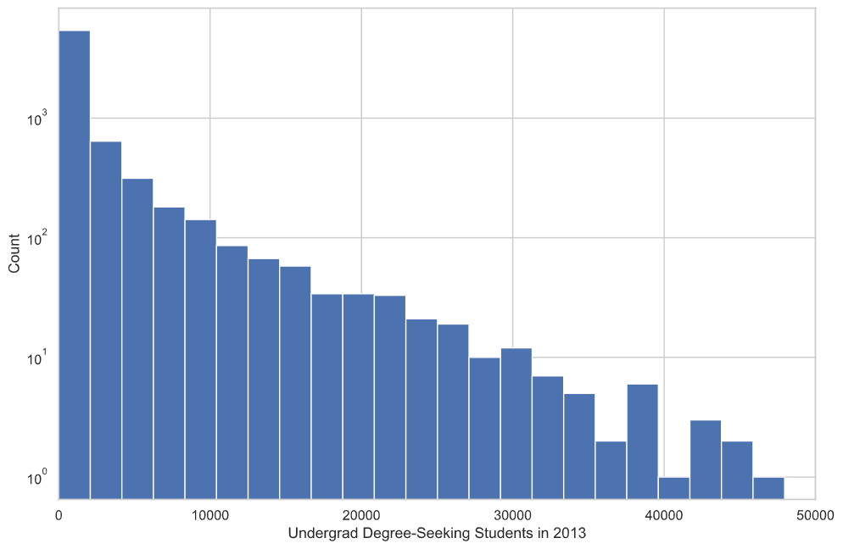
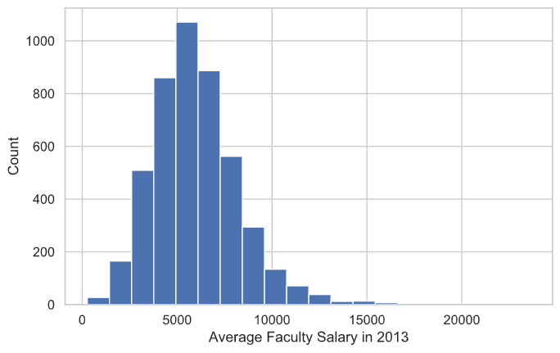
Observations

Slide 5
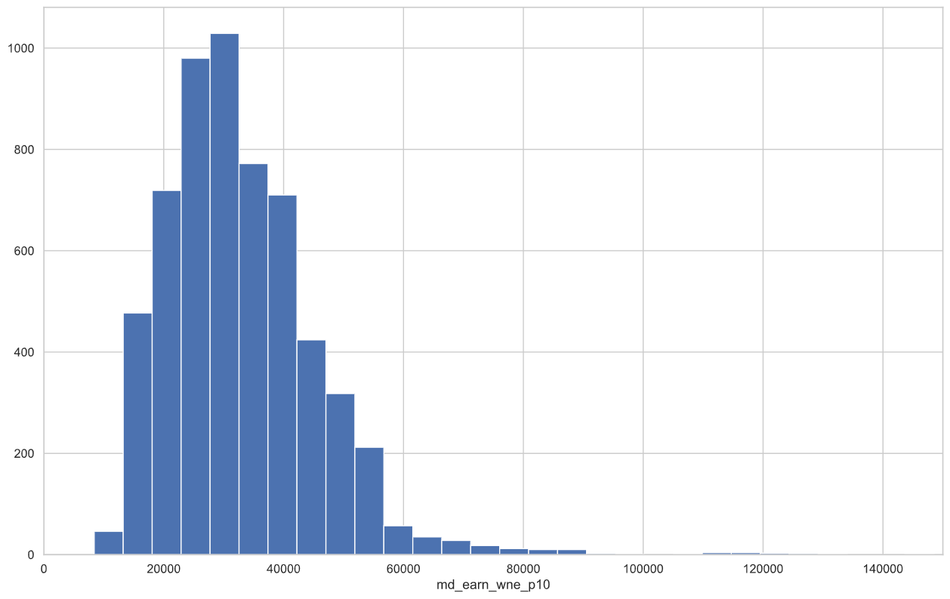
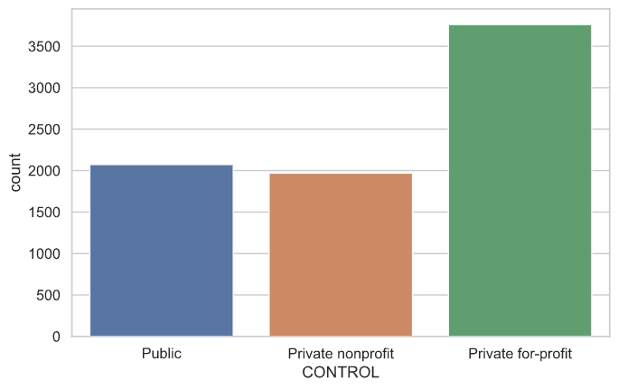
Observations

Slide 6
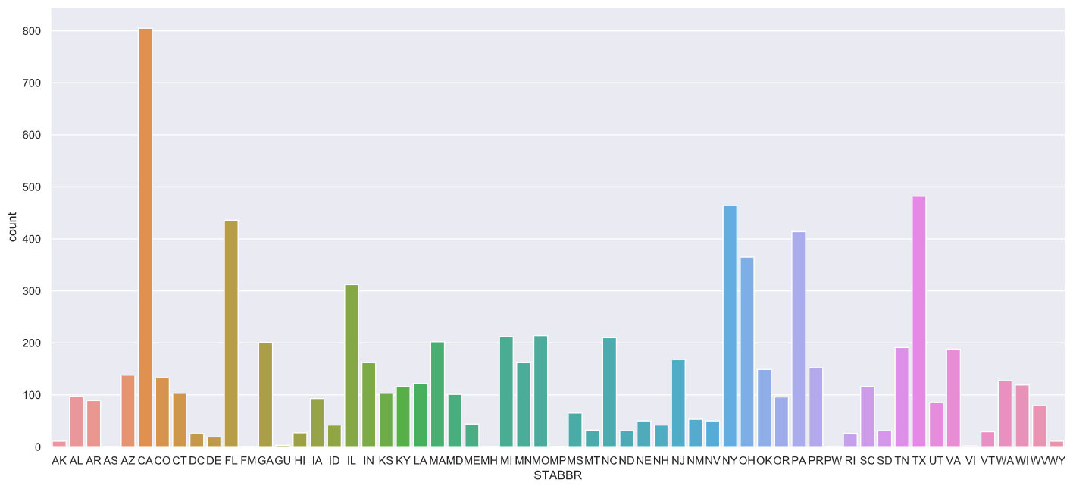
Observations

Slide 7
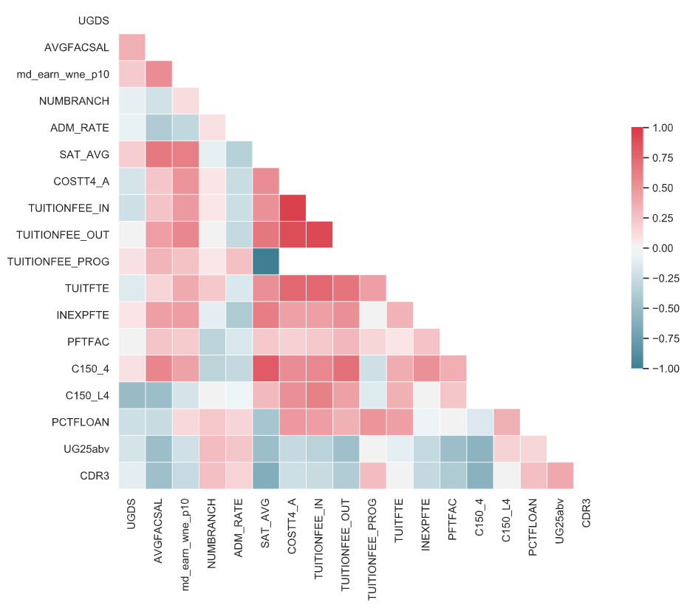
Correlations
AVGFACSAL – Average Faculty Salary
NUMBRANCH – Number of Inst. Locations
md_earn_wne_p10 – Median Annual Income after 10 yrs
ADM_Rate – Admission Rate
SAT_AVG – Average SAT Score
COSTT4_A – Avg Annual Total Cost of Attendance
TUITIONFEE_IN – In-State Tuition
TUITIONFEE_OUT – Out-of-State Tuition
TUITIONFEE_PROG – Program-based Tuition
TUITFTE – Net Tuition Revenue per FTE Student
INEXPFTE – Instructional Expenditures per FTE Student
PFTFAC – Proportion of Full-Time Faculty
C150_4 – Completion Rate (4-year institutions)
C150_L4 – Completion Rate (<4-year institutions)
PCTFLOAN – Proportion of Students with Federal Loan
UG25abv – Proportion of Students Aged 25+
CDR3 – Proportion of Borrowers in Default after 3 years

Slide 8
Analysis
Models and why you chose them

Slide 9
Simple Linear Regressions
Relationships between a university’s costs to its students and its students’ salaries after graduation.

Slide 10
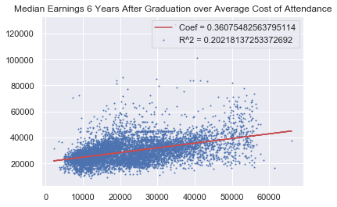

Slide 11
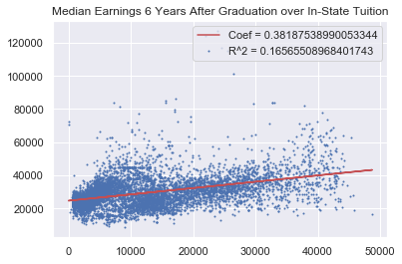

Slide 12
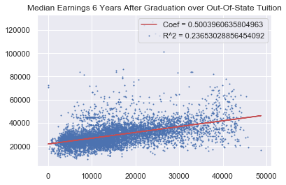

Slide 13
Predictors
Non-payment statistics that can be used to predict the post-graduation salary of a university’s students.
The goal is to obtain a predictor of “value”, not just higher post-graduation earnings.

Slide 14
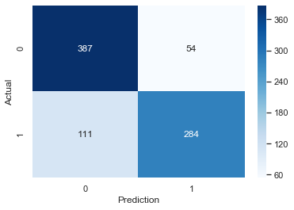
XGBoost Classification
Discretized to Above-or-Below Median 6th-Year-Earnings to Cost of Attendance ratio.
80.26% Validation Accuracy

Slide 15
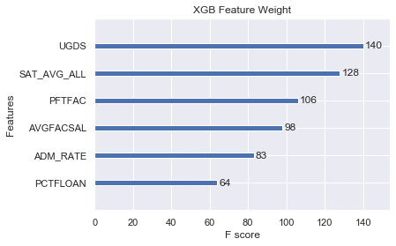

Slide 16
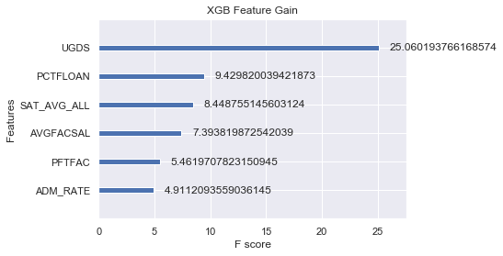

Slide 17
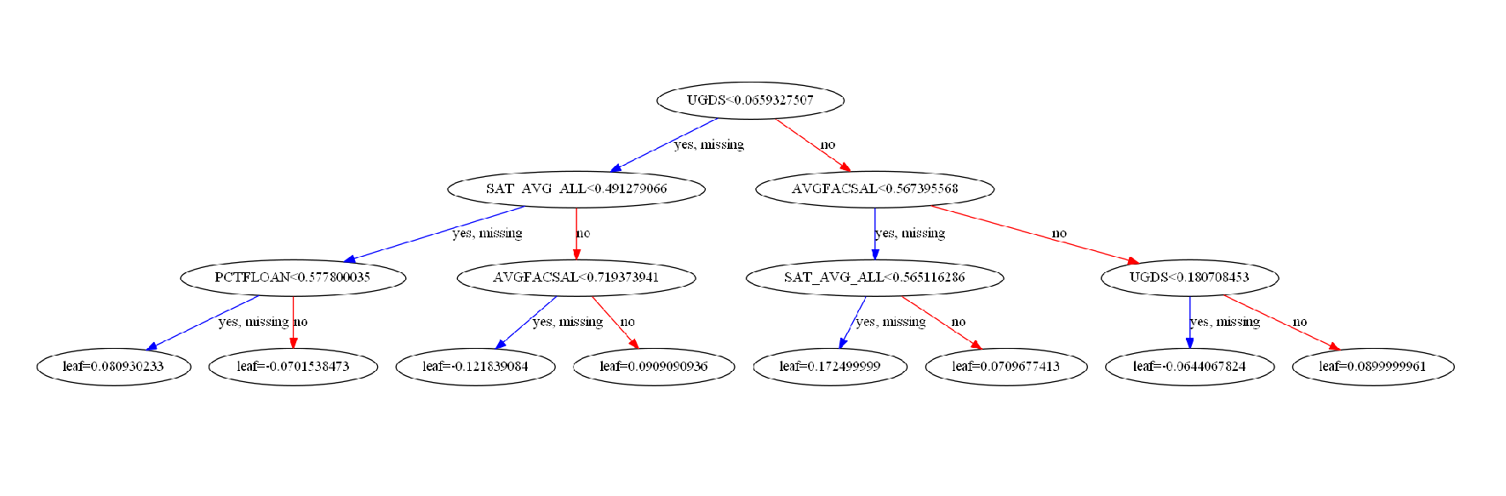
Sample Tree

Slide 18
XGBoost Regression (non-linear)
Mean Squared Error : 0.1985865
R^2 : 0.445179

Slide 19
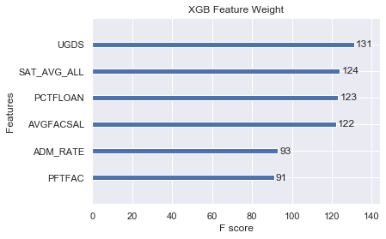

Slide 20
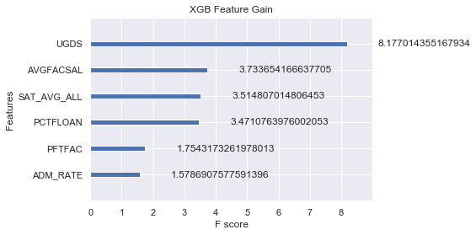

Slide 21
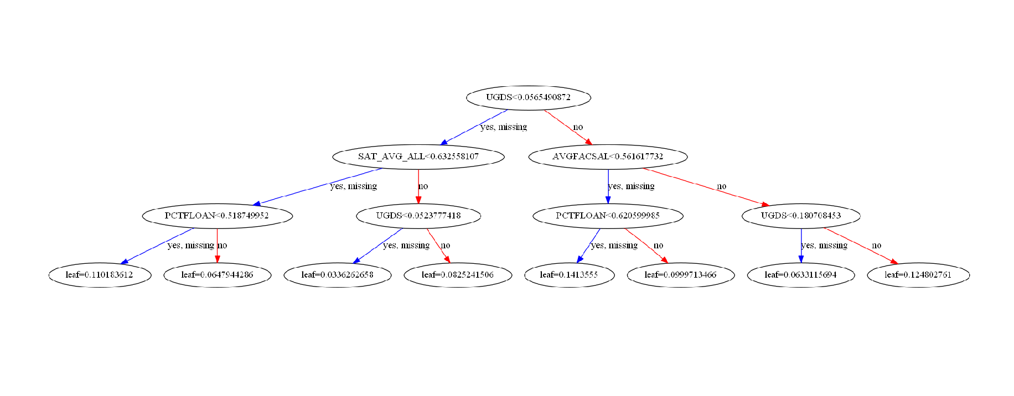
Sample Tree

Slide 22
XGBoost Linear Regression Coefficients
% Students with Loan (PCTFLOAN) | -0.027915
Admission Rate (ADM_RATE) | 0.017167
Number UG Students (UGDS) | 0.025820
SAT Scores (SAT_AVG_ALL) | -0.005916
School Under Investigation (HCM2) | -0.000728
Faculty Salary (AVGFACSAL) | 0.012946
Faculty Ratio (PFTFAC) | 0.018743
Notes:
XGBoost Linear Regression results were pretty terrible… this is just to ballpark relationships with the “value” metric.

Slide 23
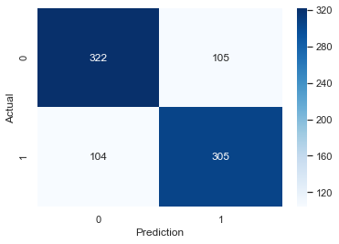
XGB Classification of Earnings
Accuracy : 0.75

Slide 24
XGB Regression of Earnings
R^2 : 0.41955171957801307

Slide 25
Recommendation
From our analysis, we can predict with marginal success which colleges will likely produce salaries that are higher than average.
We recommend to refine these models further in order to use this function when selecting schools.
We could market to apps such as Common Application in order to show new prospective students which school will give them more long term value, which is a current issue for students now.
* This dataset requires significant analysis beyond the scope of this course to account for all 1,700+ columns and 13 years worth of data for thousands of schools.

